Slide 1
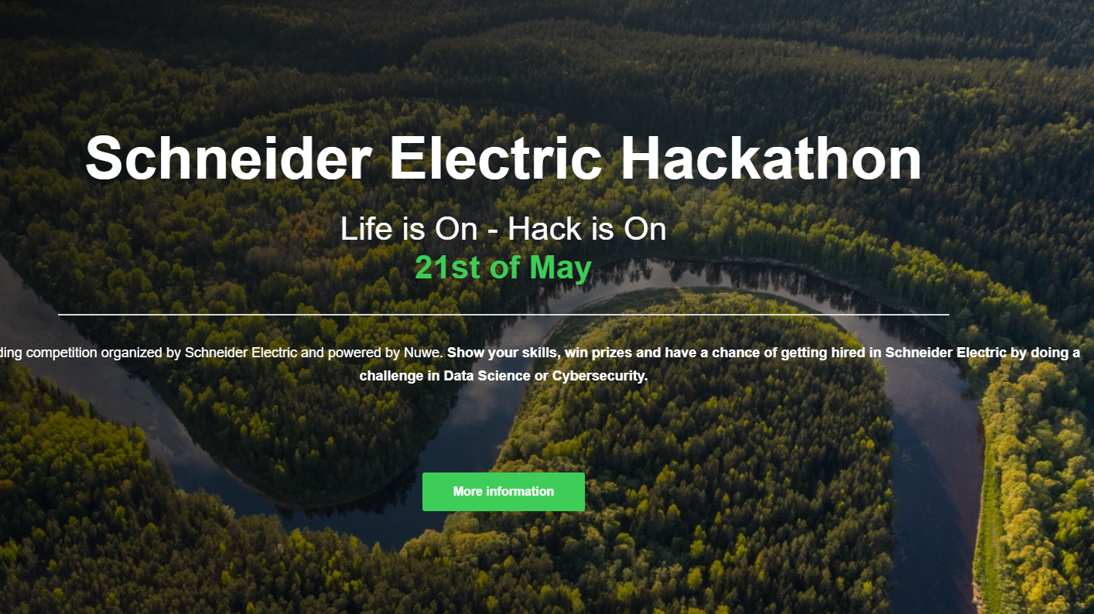
Jaime Sánchez Firth Biomedical Engineer Data Science SE – Hackathon 2022

Slide 2
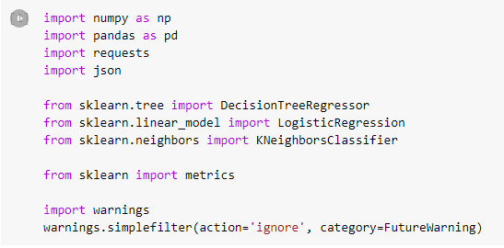
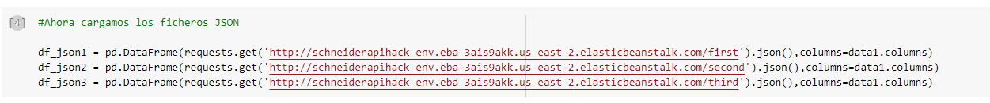
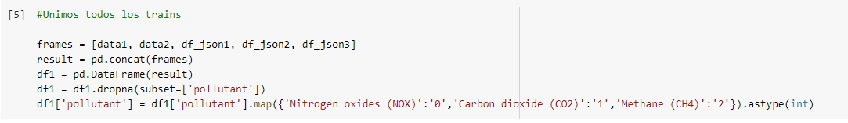
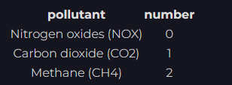
1. Obtención e interpretación de datos
The first step in this project was to obtain all data necessary for the ‘training’ of the predictive model
Necessary libraries were included, and the data was downloaded from the csv and json files
Once the dataframes with the ‘training’ information were downloaded, they were all joined into one dataframe (=‘df1’). This helps standardize the data and to work easier with it. ‘df1’ will be the ‘training’ dataframe that the predictive model will receive.
Required codes for the pollution were also done

Slide 3
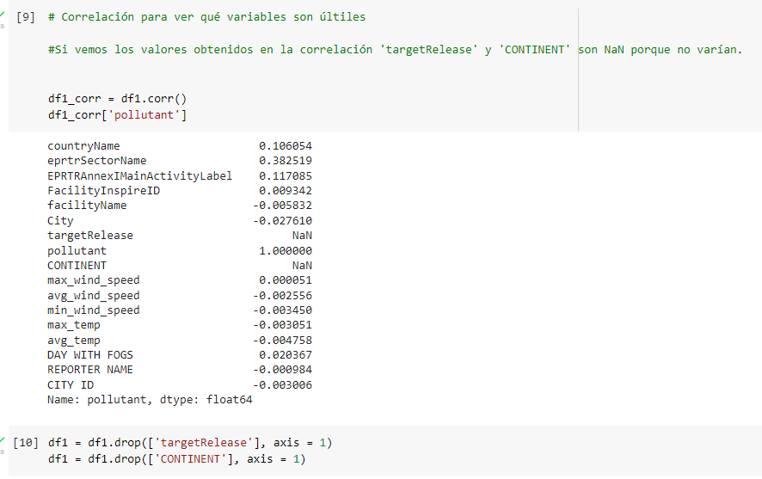
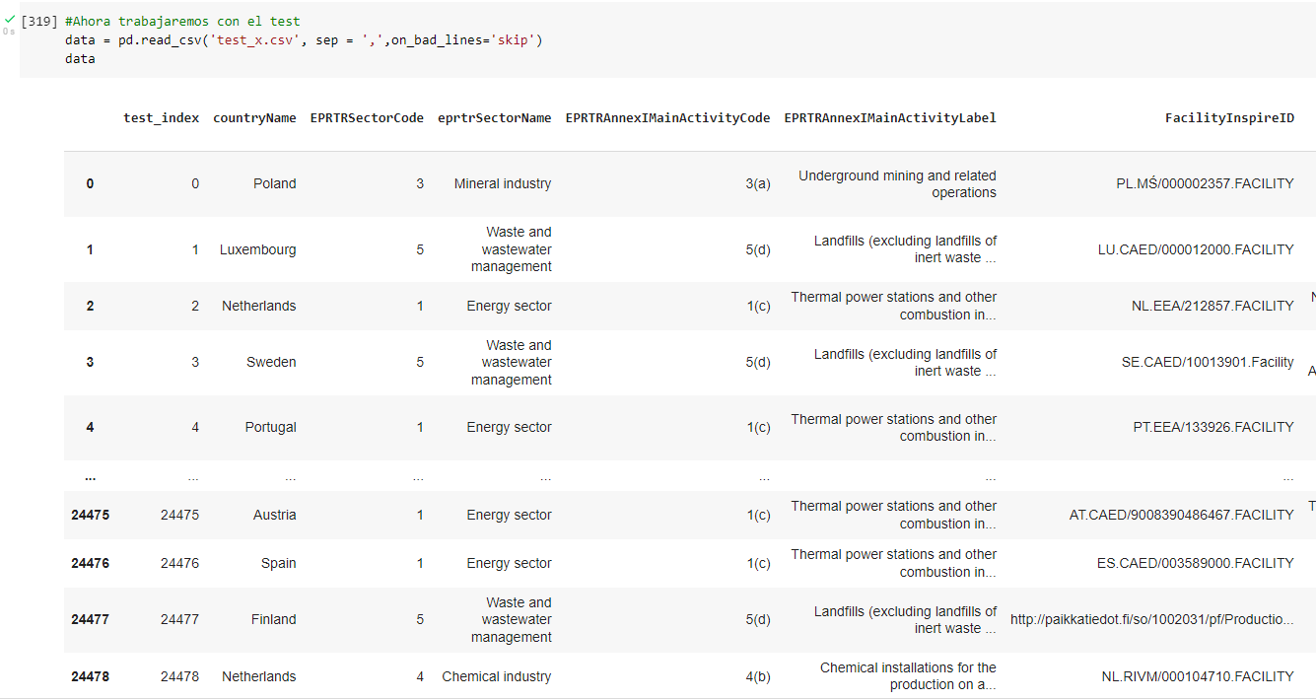
Correlation between pollution and the rest of variables was necessary in order to know which of the variables were causing noise in the analysis of the model and which ones were not useful.
Then, the same was done with the test data: it was imported into a dataframe

Slide 4
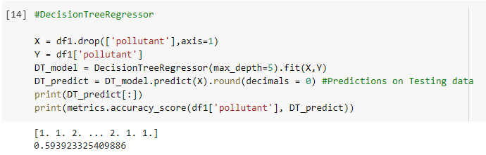
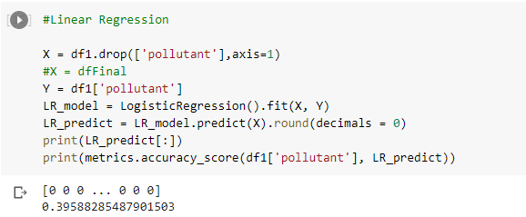
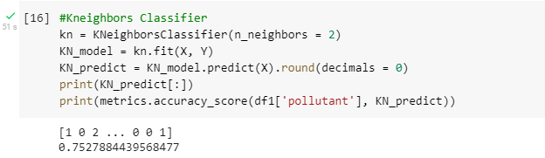
Different models
The model that better adjusts to the data is de Kneighbors classifier. I used a number of two neighbors because it gives a sifnificant model that doesn’t take too long to iterate

Slide 5
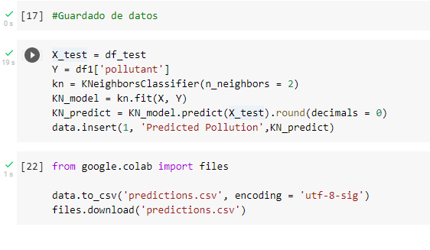
The final step was applying the model to our test and saving the predictions

Slide 6

Thank you for your attention!

